Slide 1
Part I
A Quick Intro to
vectors, vector search
and vector databases.

Slide 2


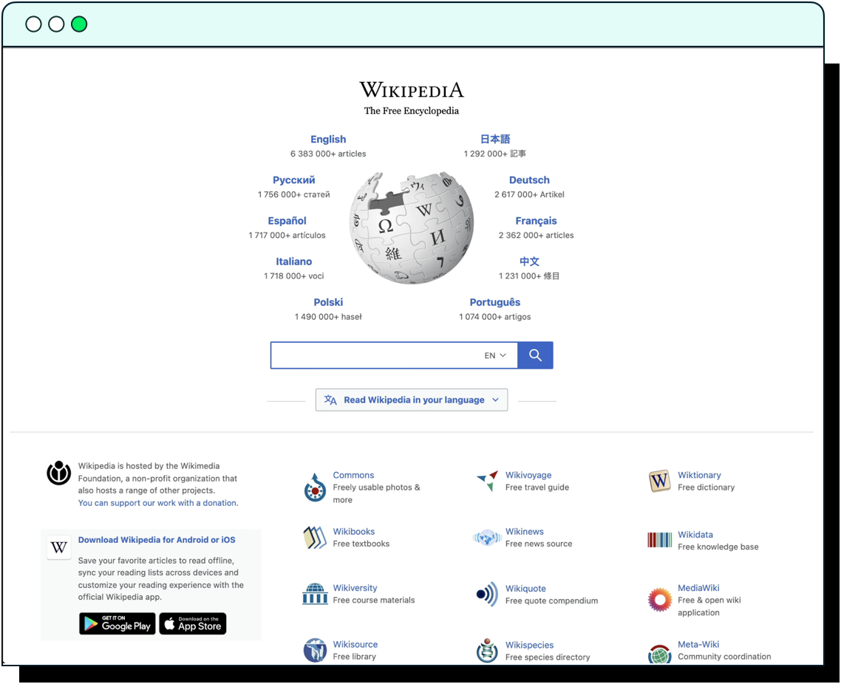


Slide 3

What is the problem?

Slide 4
The challenges of traditional search
(the keywords match)
Why do airplanes fly?
Why you should fly with ExpensiveAir’s airplanes!
…fly with ExpensiveAir’s modern fleet of airplanes to over 4 destinations. Why do you hesitate? Book now!

Slide 5

In summary

Slide 6
Semantic Search to the rescue!
Why do airplanes fly?
Dynamics of Flight - NASA
Airplane wings are shaped to make air move faster over the top of the wing. When air moves faster, the pressure of the air decreases.
Notes:
Google employs Vector Search

Slide 7


How does this work?
“You don’t need to understand it,
but it is pretty cool” 😉

Slide 8


Machine Learning models
[ 0.23, 0.45, …, 0.84, 0.23 ]
ML model

Slide 9
Vector Embeddings
[ 0.23, 0.45, …, 0.84, 0.23 ]
“Fly with ExpensiveAir’s modern fleet of airplanes to over 4 destinations. Why do you hesitate? Book now!”
ML model

Slide 10
Vector Embeddings
[ 0.23, 0.45, …, 0.84, 0.23 ]
“Fly with ExpensiveAir’s modern fleet of airplanes to over 4 destinations. Why do you hesitate? Book now!”
ML model
Airplane wings are shaped to make air move faster over the top of the wing. When air moves faster, the pressure of the air decreases.
[ 0.26, 0.31, …, 0.12, 0.44 ]

Slide 11
Vector Embeddings
[ 0.23, 0.45, …, 0.84, 0.23 ]
“Fly with ExpensiveAir’s modern fleet of airplanes to over 4 destinations. Why do you hesitate? Book now!”
ML model
Airplane wings are shaped to make air move faster over the top of the wing. When air moves faster, the pressure of the air decreases.
[ 0.26, 0.31, …, 0.12, 0.44 ]

Slide 12
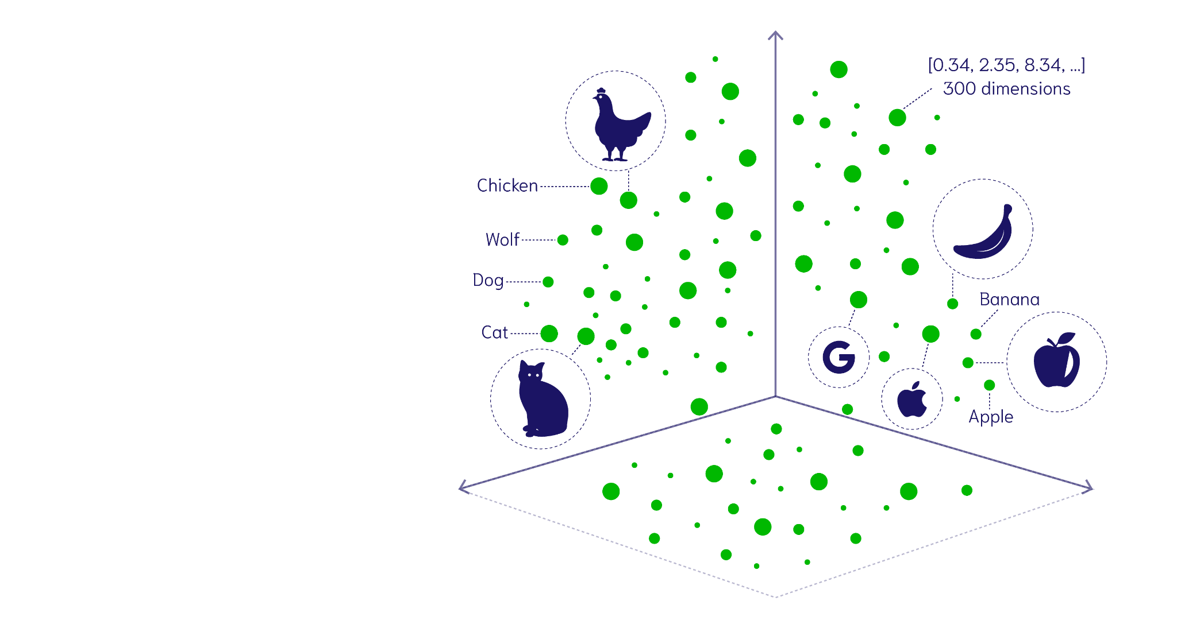
Vector Space
[ 0.23, 0.45, …, 0.84, 0.23 ]
[ 0.26, 0.31, …, 0.12, 0.44 ]

Slide 13
Vector Search
Why do airplanes fly?
ML model

Slide 14
Vector Search
Why do airplanes fly?
ML model
[ 0.24, 0.36, …, 0.16, 0.46 ]

Slide 15
Vector Search
Why do airplanes fly?
ML model
[ 0.24, 0.36, …, 0.16, 0.46 ]

Slide 16
Vector Search
Why do airplanes fly?
ML model
[ 0.24, 0.36, …, 0.16, 0.46 ]
[ 0.26, 0.31, …, 0.12, 0.44 ] The NASA article
Notes:
Why are there images and text dots on the vector space?!?

Slide 17
Part II
Vector Databases
can handle alot more than text!

Slide 18
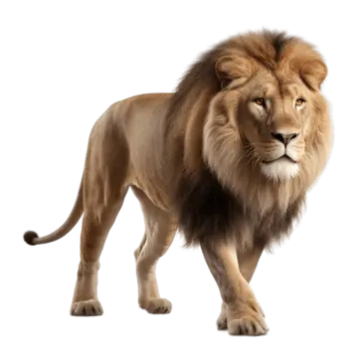
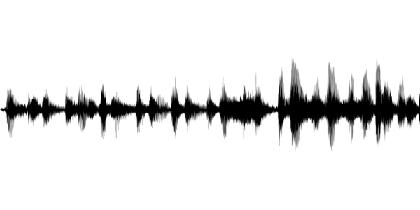
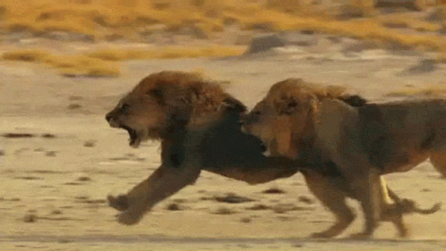
Multimodal Embeddings
The lion is the king of the savannas.
Text Encoder
[-0.10, 0.02, 0.14, …, 0.48]
Image Encoder
[-0.12, 0.03, 0.14, …, 0.52]
Audio Encoder
[-0.11, 0.01, 0.15, …, 0.55]
Video Encoder
[-0.21, 0.05, 0.17, …, 0.59]

Slide 19
Multimodal Embeddings
The lion is the king of the jungle.
Text Encoder
[-0.10, 0.02, 0.14, …, 0.48]
Image Encoder
[-0.12, 0.03, 0.14, …, 0.52]
Audio Encoder
[-0.11, 0.01, 0.15, …, 0.55]
Video Encoder
[-0.21, 0.05, 0.17, …, 0.59]

Slide 20
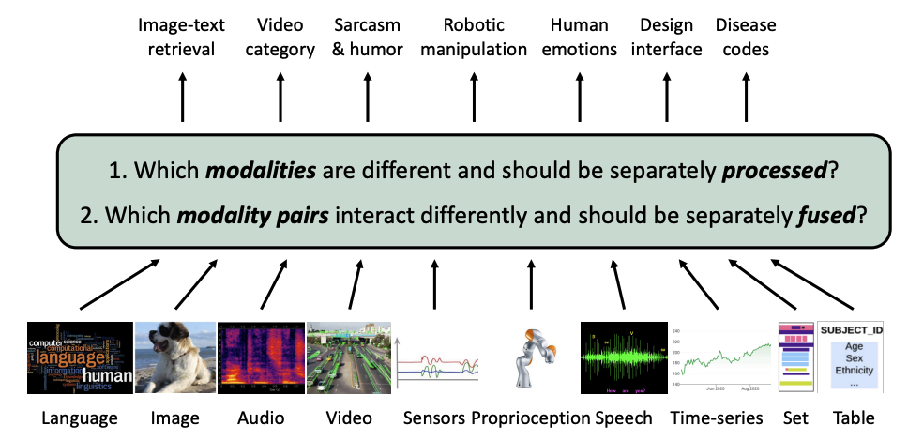
This generates one unified vector space…
Multimodal Embeddings

Slide 21




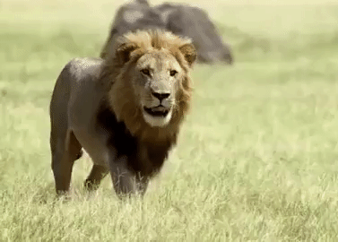

…and enables any-to-any search!
Lions roam the savannas.

Slide 22
How does that help with Generative AI / LLMs?
Notes:
An open-source vector search engine & database that understands your data

Slide 23


To scale this approach we need a Vector Database!
A picture is worth a 1000 words …
Why stop at retrieving text context?
Multimodal R.A.G!
LLM
LLM
https://github.com/weaviate-tutorials/multimodal-workshop
Notes:
Two things this computer needs to be able to do:
Understand and read the documents
Filter through them at super-human speeds

